Slide 1
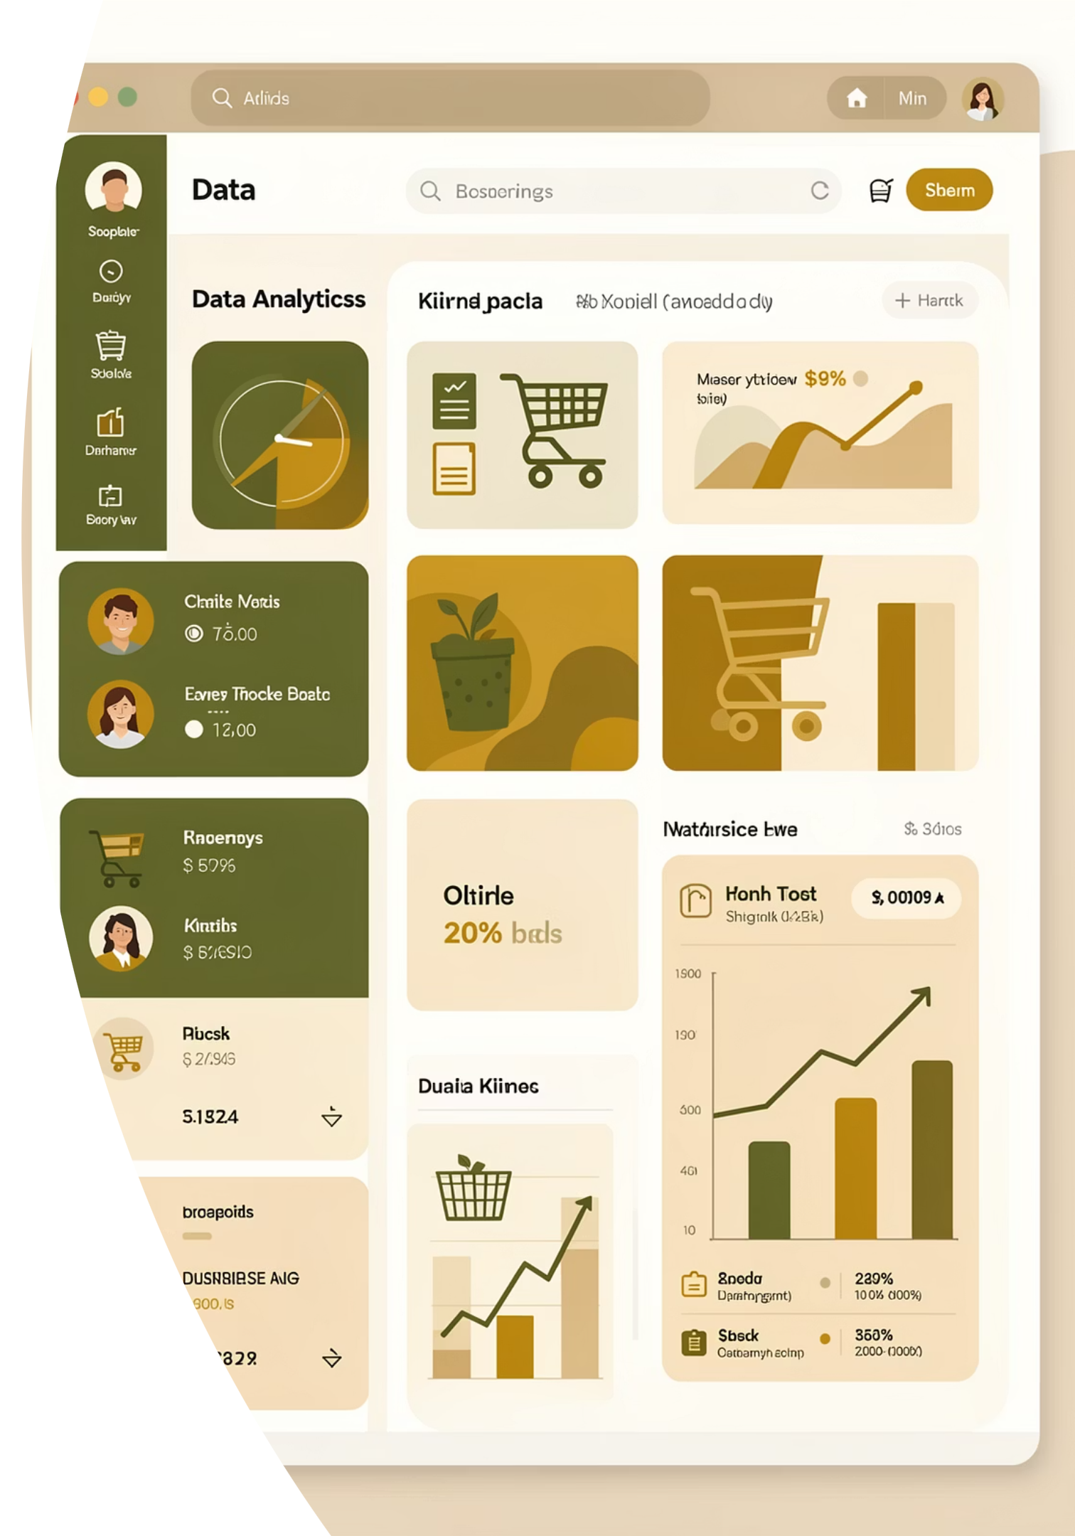
Customer Shopping Behavior Analysis
Uncovering insights from 3,900 purchases to guide strategic business decisions through data-driven analysis of spending patterns, customer segments, and product preferences.

Slide 2
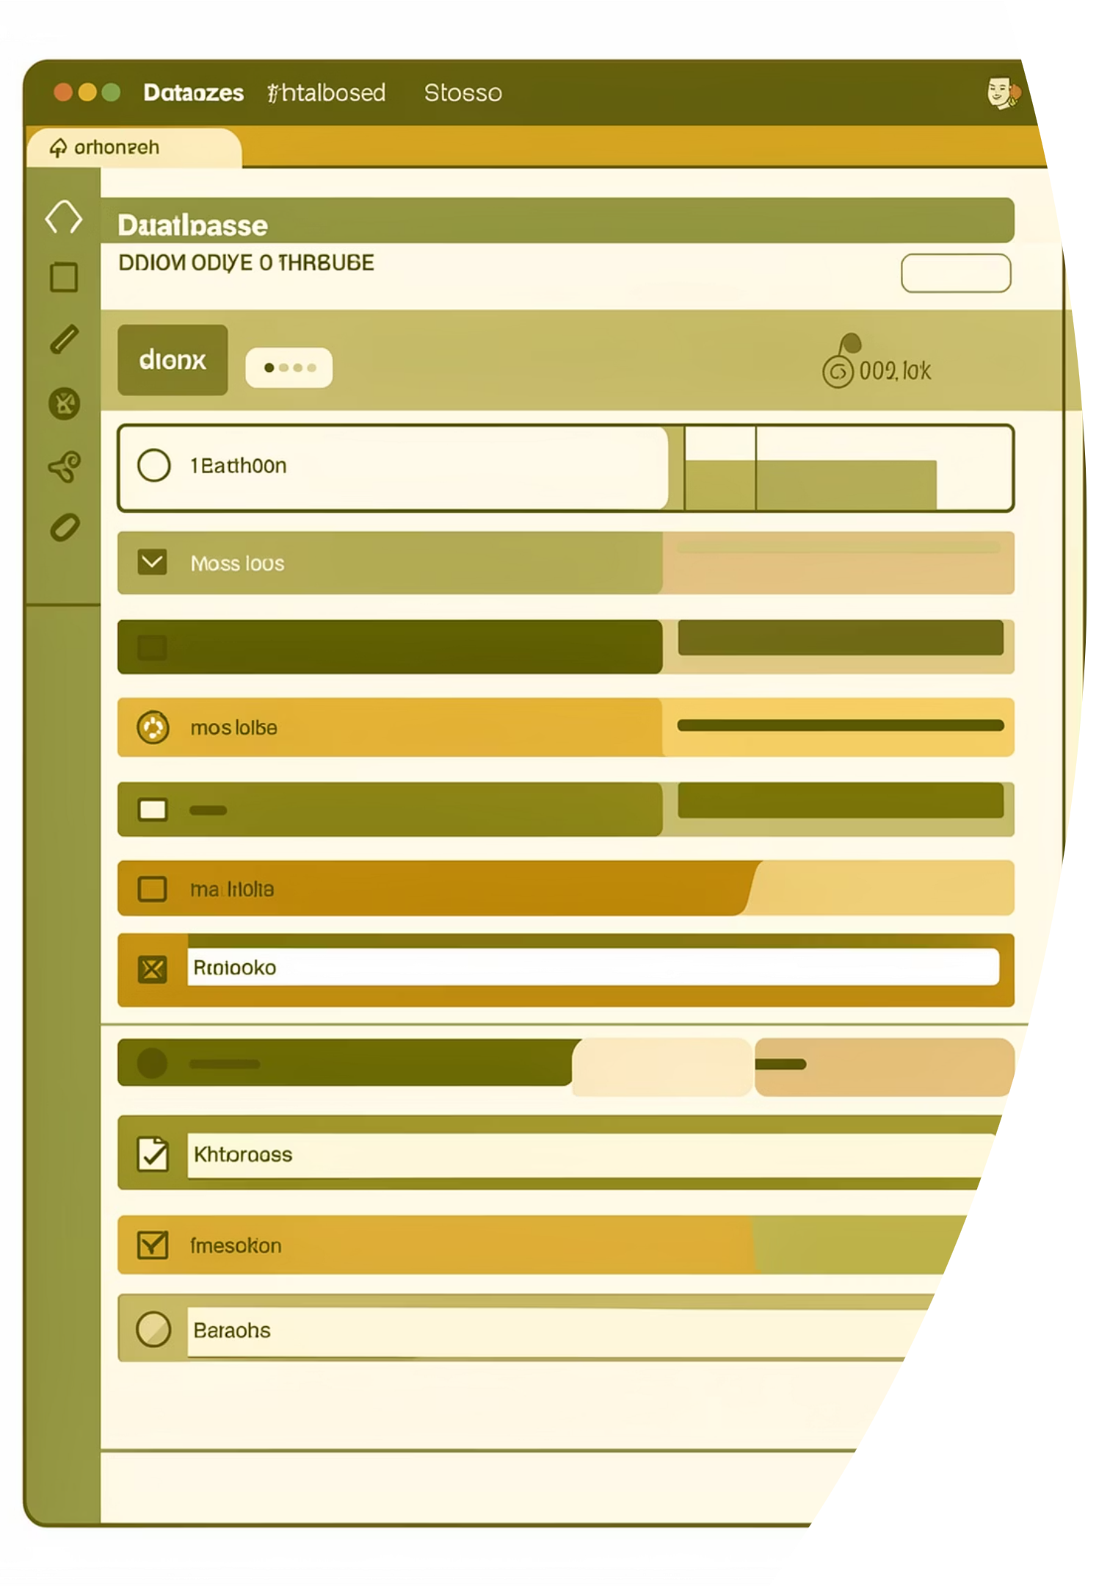

DATASET OVERVIEW
Foundation: Our Data
3,900
18
50
Total Purchases
Data Features
Locations
Comprehensive transaction records analyzed
Demographics, purchases, and behavior metrics
Geographic diversity across customer base
Key dimensions include customer demographics, purchase details across 4 product categories, and shopping behavior patterns including discounts, reviews, and shipping preferences.

Slide 3

DATA PREPARATION
Python Analysis Pipeline
01
Data Loading & Exploration
Imported dataset with pandas, examined structure and summary statistics
02
Cleaning & Standardization
Handled 37 missing review ratings using median imputation, standardized column names
03
Feature Engineering
Created age groups and purchase frequency metrics for deeper insights
04
Database Integration
Connected to PostgreSQL for advanced SQL analysis

Slide 4
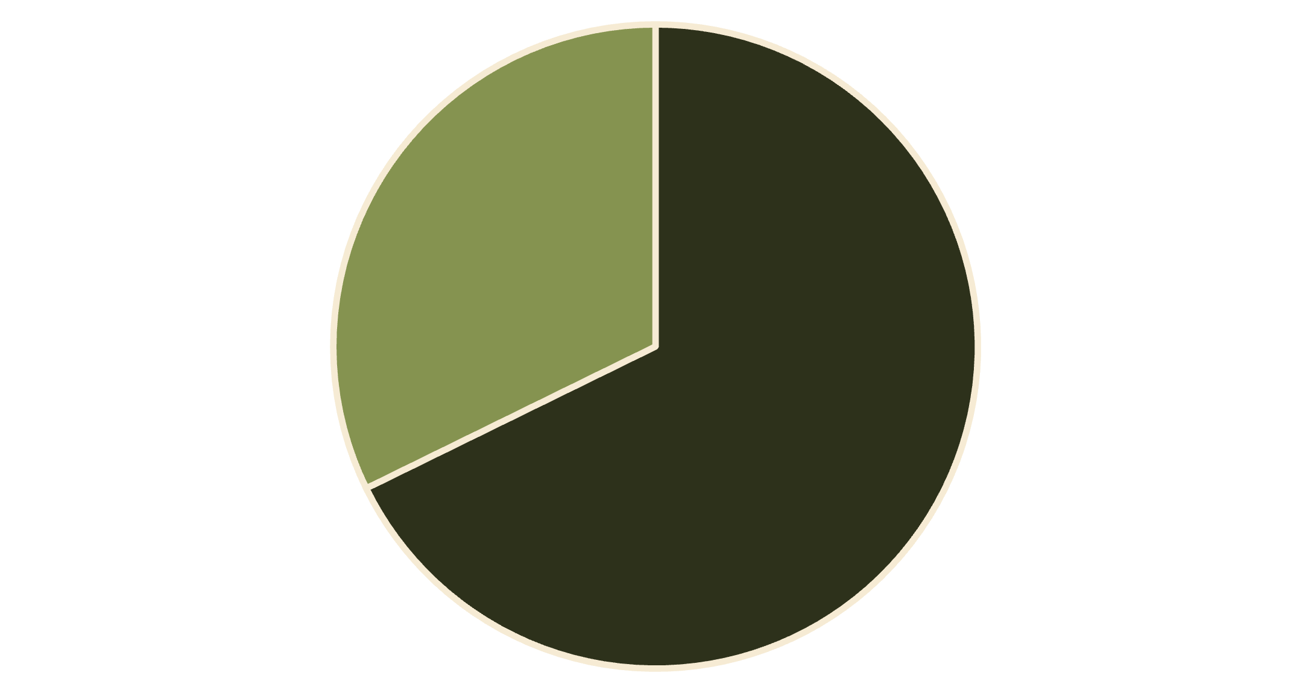
Revenue Insights by Gender
Male Customers Drive Revenue
Male customers generated $157,890 in total revenue compared to $75,191 from female customers—representing 68% of total revenue despite being 68% of the customer base.
This alignment suggests consistent spending patterns across genders, with opportunities to increase female customer engagement.
Male
Female

Slide 5
Product Performance Leaders
Top-Rated Products
Customer satisfaction drives repeat purchases. Our highest-rated items show consistent quality across categories:
77%
77%
76%
Gloves
Sandals
Boots
3.86 average rating
3.84 average rating
3.82 average rating

Slide 6
KEY FINDING
Smart Discount Users
839
High-Value Customers
Used discounts but spent above average
These customers represent a valuable segment: discount-conscious yet willing to spend significantly. They used promotional offers strategically while maintaining purchase amounts above the $59.76 average.
Opportunity: Target this segment with exclusive offers to drive loyalty without sacrificing margins.

Slide 7



Customer Segmentation Analysis
Loyal Customers
Returning Customers
New Customers
3,116 customers (80%)
701 customers (18%)
83 customers (2%)
Frequent purchasers driving consistent revenue
Growing engagement with repeat purchases
Fresh acquisition opportunities for growth
Our customer base shows strong loyalty with 80% classified as loyal buyers. Focus on converting the 18% returning segment into loyal customers through targeted engagement.

Slide 8
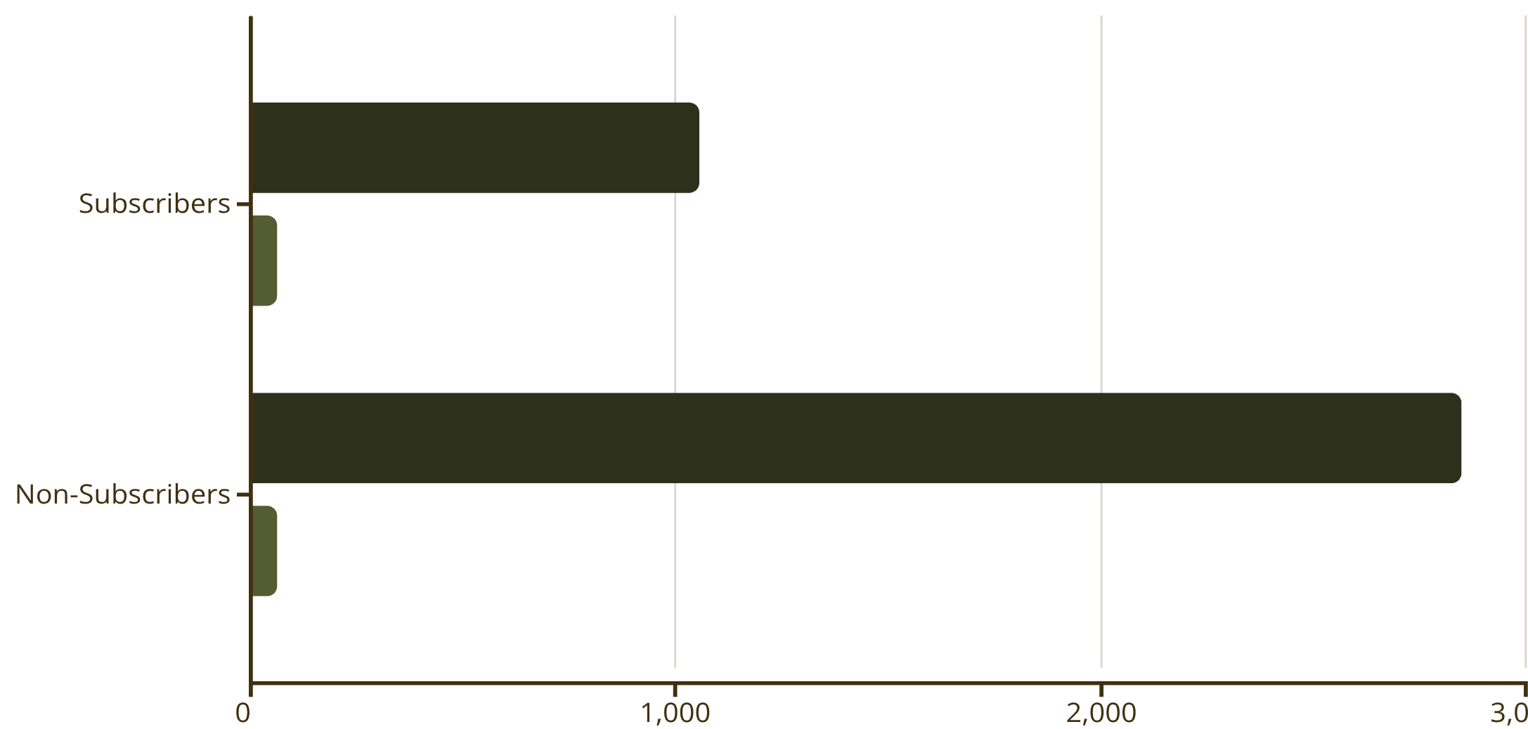
Subscription Impact
Subscription Opportunity
Only 27% of customers subscribe, yet they contribute $62,645 in revenue. Average spend is comparable between groups ($59.49 vs $59.87).
Insight: Among repeat buyers (5+ purchases), 958 subscribe while 2,518 don't—a massive untapped opportunity for subscription growth.
Customers
Avg Spend

Slide 9

Revenue Distribution
Young Adult
Middle-aged
Adult
$62,143 total revenue
$59,197 total revenue
$55,978 total revenue
Highest revenue contributor
Strong purchasing power
Consistent spending patterns
Senior
$55,763 total revenue
Stable customer segment
Revenue is well-distributed across age groups, with Young Adults leading. Clothing dominates at $100K revenue, followed by Accessories ($70K), Footwear ($30K), and Outerwear ($20K).

Slide 10
STRATEGIC RECOMMENDATIONS
Action Plan for Growth
Boost Subscriptions
1
Promote exclusive benefits to convert the 73% non-subscribers, especially among repeat buyers
Loyalty Programs
2
Reward repeat buyers to accelerate movement from Returning to Loyal segment
Optimize Discounts
3
Balance promotional offers with margin control—target smart discount users strategically
Product Positioning
4
Highlight top-rated items (Gloves, Sandals, Boots) in marketing campaigns
Targeted Marketing
5
Focus on Young Adults and express-shipping users for maximum revenue impact

